Slide 1
Data Mining: Movies
IST 707 July 2019
Project Team Members:
Pierre Casco
Valerie Fowler
Elia Kostyrka

Slide 2
Outline
Introduction, Data and Goals
5 Key Analysis w/Results
Conclusions from Analysis

Slide 3

Introduction, Data and Goals
Progress of cinema over time
Affects of technology
Affect on revenue and movie production (cinema v. streaming)
Movie data
Goals
Identify areas that could provide entertain value
Profitability of specific categories, including rating, genre, etc.
Identify models that could predict future success

Slide 4

Methodology for Analysis and Investigation for a Solution
Clustering (unsupervised learning)
Simple K-Means
Classification (supervised learning)
Decision Tree
Naïve Bayes
K-NN
SVM
Random Forrest
Text Mining
Word Frequencies

Slide 5
Clustering
Preprocessing - All attributes not nominal were discretized. Attributes used included genre, top stars, directors, writers, and production companies (top 97th percentile with 7+ rating total movies for each category), gross revenue in the us, runtime, IMDb scores, and successful category (movie reached 7+ IMDb rating).
Weka parameters – SimpleKMeans clustering, Euclidean distance, 3 clusters, 500 max iterations, and 10 random seeds were used to identify clusters in the data associated with successful movies.
Findings - Cluster 2 showed the mode successful attribute was “yes” so this is the cluster we focused on. The mode for this cluster were rated R movies, dramas, no top stars, but included top directors, writers, and production companies. The mode IMDb scores were between 6.96-7.74 and had longer runtimes (113-144 minutes).
Top performers link

Slide 6
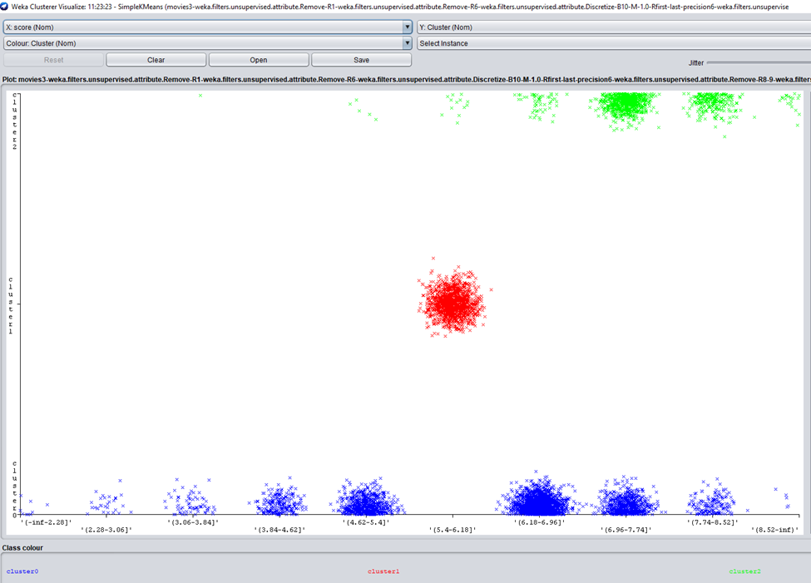
Clustering (Clusters and IMBd Scores)
Cluster 0, blue – not successful mode
Cluster 1, red – not successful mode
Cluster 2, green – successful mode

Slide 7
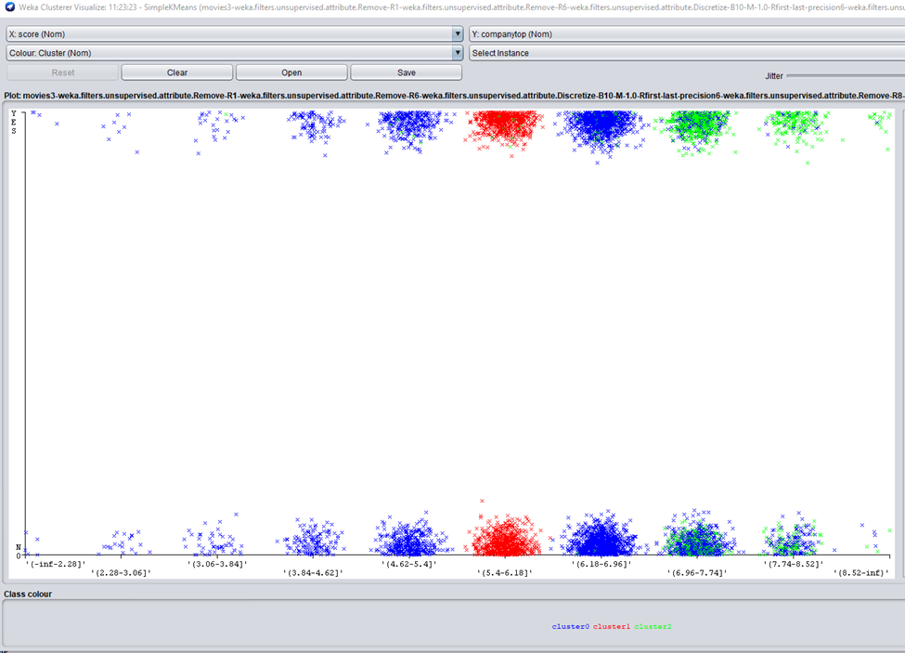
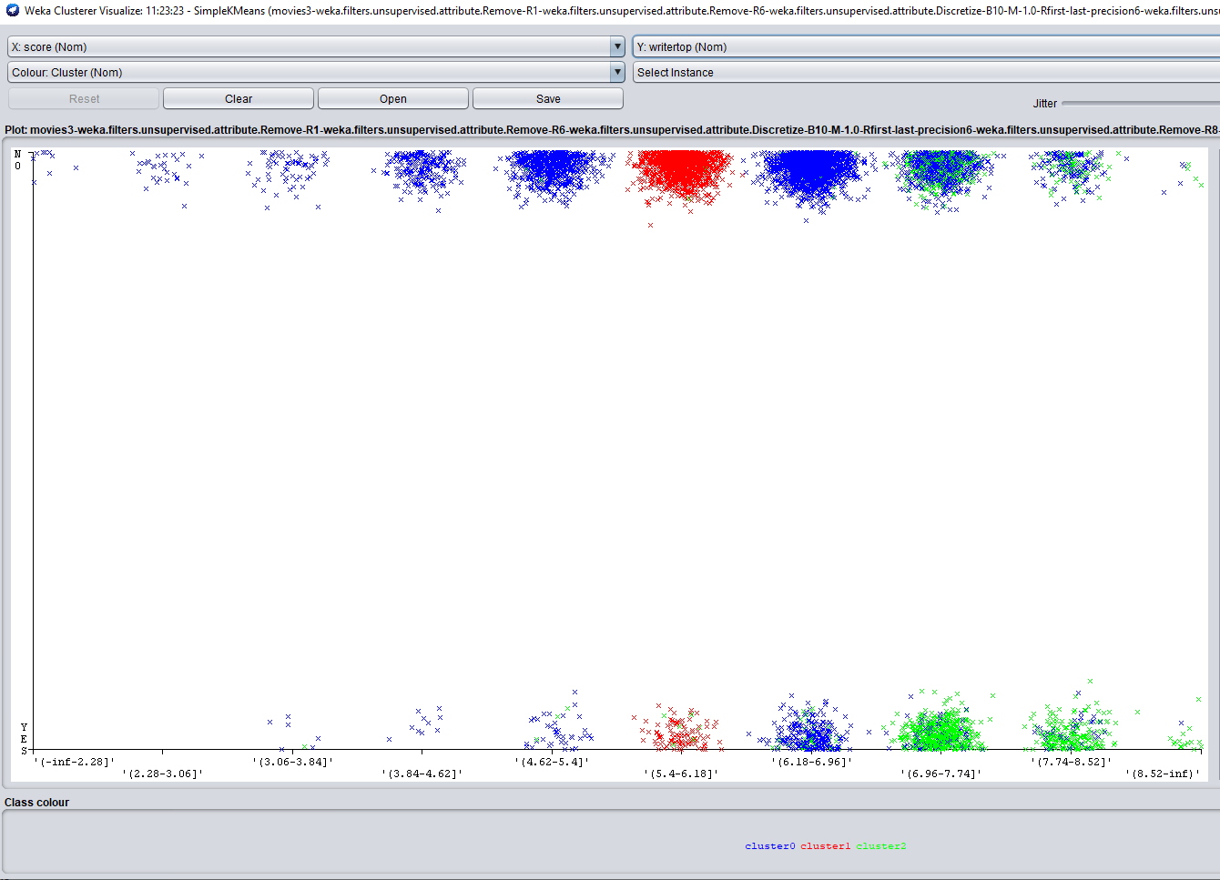
Clustering (IMDb Scores and Top Companies and Top Writers)

Slide 8
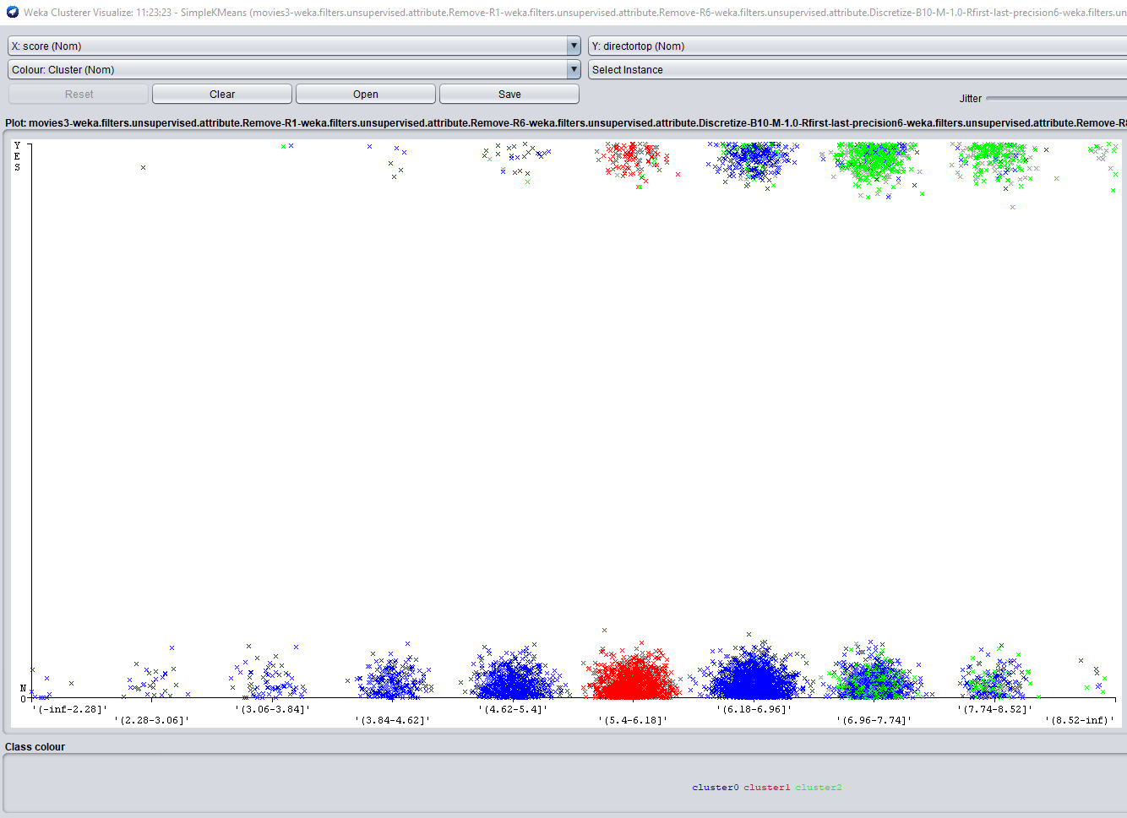
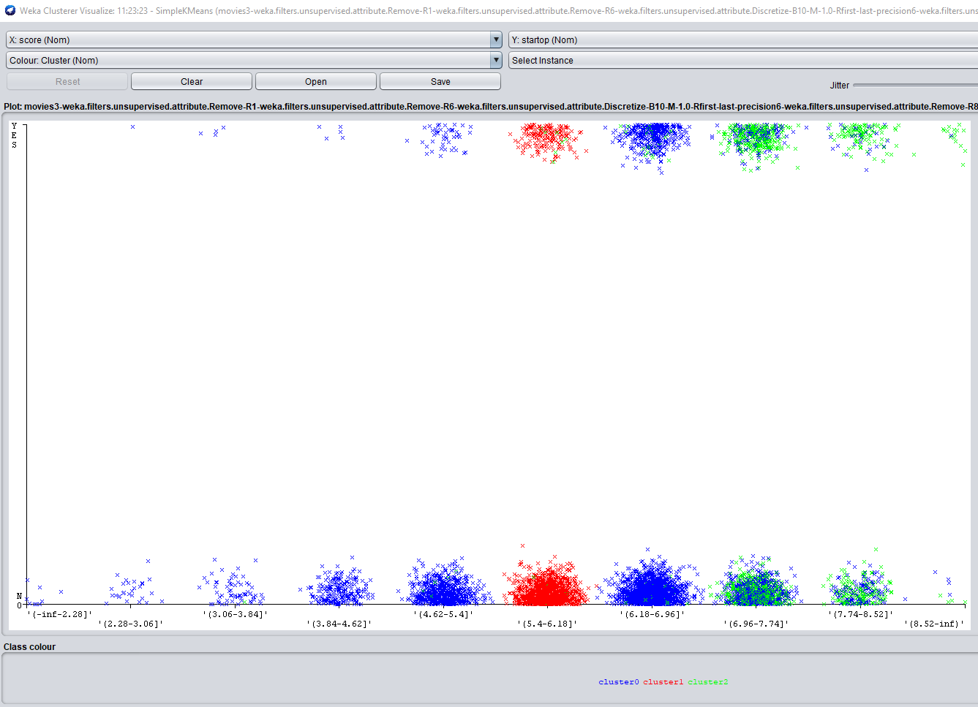
Clustering (IMDb Scores and Top Directors and Top Stars)

Slide 9
Classification (Decision Tree)
Preprocessing – New attributes were created (columns added), top performing categories (stars, directors, writers, production companies with movies that were in the top 97th percentile of all movies that had a 7+ rating) were identified and put in binary form (YES/NO), data types were changed for two attributes, and the category names of the genre category were listed as abbreviations for easy reference in the results.
RWeka parameters – A decision tree was built in R using J48 (parameters – unpruned tree, 2 number of instances per tree, .5 pruning confidence, 3 numfolds, and 1 seed) to determine the percentage of correctly classified instances
Findings –
Using a top writer and top production company were more likely to predict a successful movie.
Only the genre “comedy” was segmented out to predict score level. Comedies that used a top director produced more movies with higher scores. Action movies with a top director could predict score level as well.

Slide 10
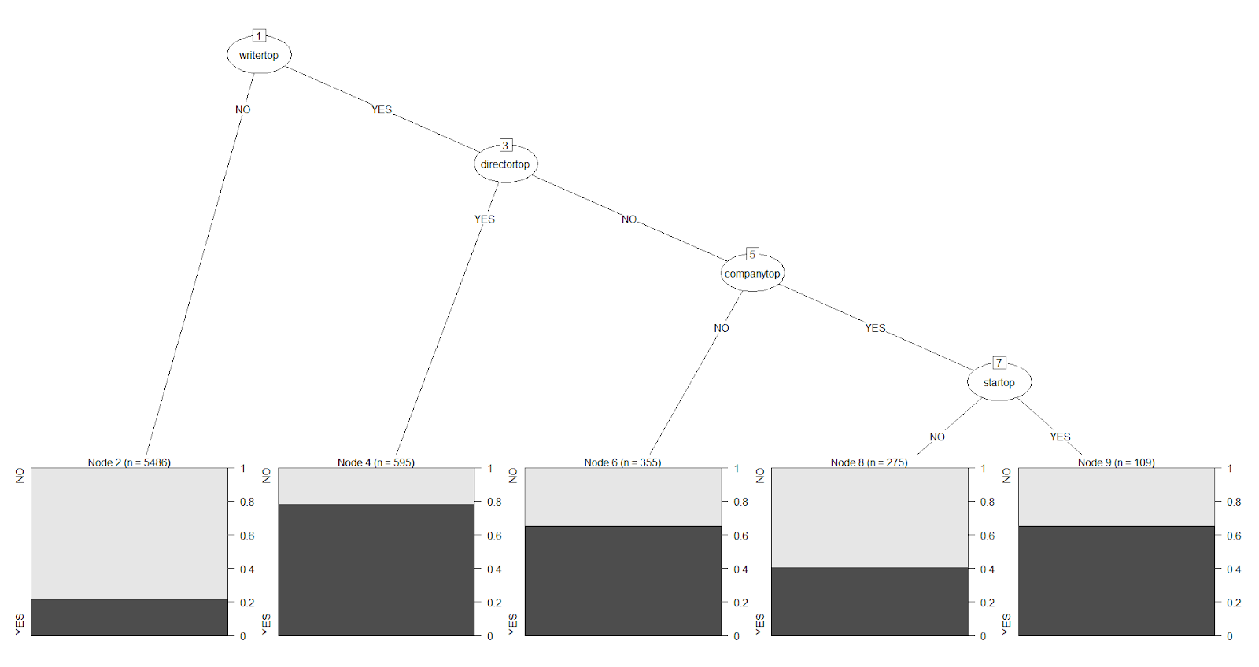
Classification (Decision Tree)
Top writer and top production company were more likely to predict a successful movie.

Slide 11
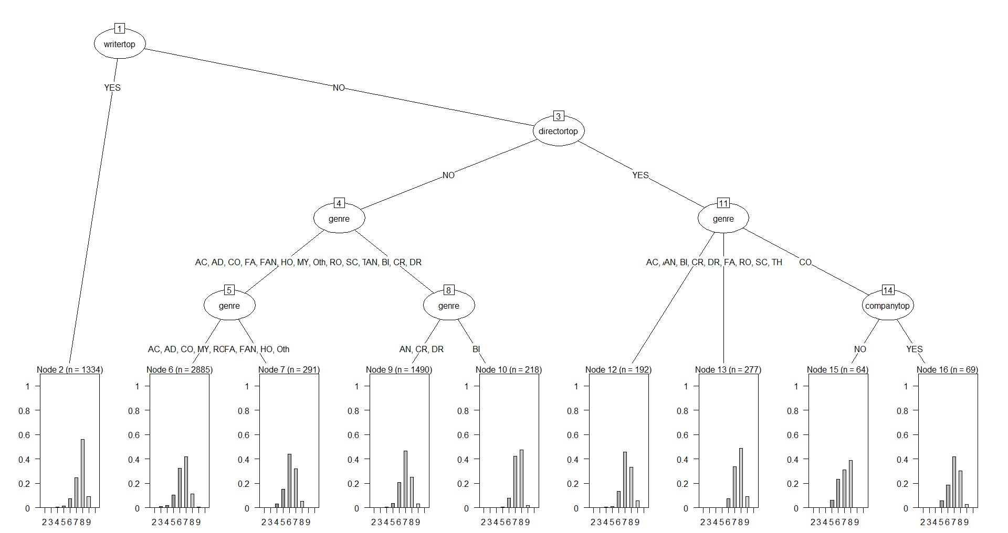
Classification (Decision Tree)
Top writers could predict score. Only the genre “comedy” was segmented out to predict score level. Comedies that used a top director produced more movies with higher scores. Action movies with a top director could predict score level as well.

Slide 12

Classification (Naïve Bayes)
Preprocessing – New attributes were created (columns added), top performing categories (stars, directors, writers, production companies with movies that were in the top 97th percentile of all movies that had a 7+ rating) were identified and put in binary form (YES/NO) along with whether a movie was successful (7+ IMDb score). Other attributes used included genre and rating (e.g., PG, R, etc.).
Parameters - Naïve Bayes model was built in R using e1071 (parameters – 3-fold CV).
Findings - Naïve Bayes model had the ability to predict unsuccessful movies by 90.4% and decreased to 55.1% success of predicting the yes cases on the test data (see confusion matrix).

Slide 13
Classification (SVM, k-NN, Random Forest)
Three algorithms were compared for classification analysis to identify a model that could provide higher accuracy, SVM, k-NN, and Random Forest.
Preprocessing. New attributes were created (top performers) and put in binary form (YES/NO).
Parameters
K-NN: Weka cross-validation of 3 folds, different k nearest neighbors (0.5, 1, 5, 10) , and both distance weighting of weight by 1-distance and weight by 1/distance.
SVM: Weka cross-validation of 3 folds, different cost amounts (0.3, 0.5, 0.8 1.0), and both the default Poly kernel and RBF kernel.
Random Forest: Weka cross-validation of 3 folds and different number of trees (2, 5, 10, 15).
Findings - The k-NN training model was able to more accurately predict successful movies given the attributes rating, genre, top stars, directors, writers, and companies, and successful category (IMDb rating of 7 or more).

Slide 14
Classification (k-NN Model)
=== Stratified cross-validation ===
=== Summary ===
Correctly Classified Instances 5376 78.827 %
Incorrectly Classified Instances 1444 21.173 %
Kappa statistic 0.3618
Mean absolute error 0.2738
Root mean squared error 0.3844
Relative absolute error 70.0793 %
Root relative squared error 86.9733 %
Total Number of Instances 6820
=== Detailed Accuracy By Class ===
TP Rate FP Rate Precision Recall F-Measure MCC ROC Area PRC Area Class
0.366 0.059 0.694 0.366 0.479 0.391 0.812 0.617 yes
0.941 0.634 0.804 0.941 0.867 0.391 0.812 0.915 no
Weighted Avg. 0.788 0.481 0.774 0.788 0.764 0.391 0.812 0.835
=== Confusion Matrix ===
a b <-- classified as
664 1151 | a = yes
293 4712 | b = no
The k-NN model had the ability to predict unsuccessful movies by 80% and decreased to 69.4% success of predicting the yes cases on the data (see confusion matrix).

Slide 15
Classification (SVM Model)
=== Stratified cross-validation ===
=== Summary ===
Correctly Classified Instances 5449 79.8974 %
Incorrectly Classified Instances 1371 20.1026 %
Kappa statistic 0.4372
Mean absolute error 0.201
Root mean squared error 0.4484
Relative absolute error 51.4596 %
Root relative squared error 101.4543 %
Total Number of Instances 6820
=== Detailed Accuracy By Class ===
TP Rate FP Rate Precision Recall F-Measure MCC ROC Area PRC Area Class
0.488 0.088 0.667 0.488 0.564 0.446 0.700 0.462 yes
0.912 0.512 0.831 0.912 0.869 0.446 0.700 0.822 no
Weighted Avg. 0.799 0.399 0.787 0.799 0.788 0.446 0.700 0.726
=== Confusion Matrix ===
a b <-- classified as
886 929 | a = yes
442 4563 | b = no
The SVM model had the ability to predict unsuccessful movies by 83% and decreased to 66.7% success of predicting the yes cases on the data (see confusion matrix).

Slide 16
Classification (Random Forest Model)
=== Stratified cross-validation ===
=== Summary ===
Correctly Classified Instances 5345 78.3724 %
Incorrectly Classified Instances 1475 21.6276 %
Kappa statistic 0.4019
Mean absolute error 0.2696
Root mean squared error 0.3951
Relative absolute error 69.0123 %
Root relative squared error 89.3938 %
Total Number of Instances 6820
=== Detailed Accuracy By Class ===
TP Rate FP Rate Precision Recall F-Measure MCC ROC Area PRC Area Class
0.477 0.105 0.622 0.477 0.540 0.408 0.795 0.575 yes
0.895 0.523 0.825 0.895 0.859 0.408 0.795 0.899 no
Weighted Avg. 0.784 0.412 0.771 0.784 0.774 0.408 0.795 0.813
=== Confusion Matrix ===
a b <-- classified as
866 949 | a = yes
526 4479 | b = no
The Random Forrest model had the ability to predict unsuccessful movies by 82.5% and decreased to 62.2% success of predicting the yes cases on the data (see confusion matrix).

Slide 17
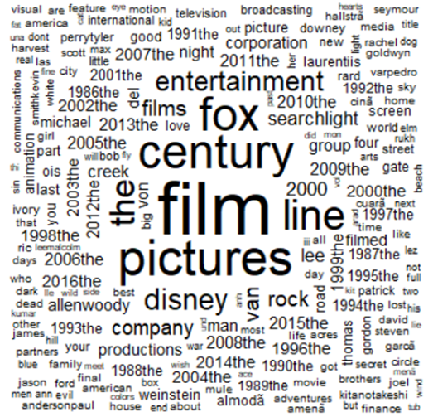
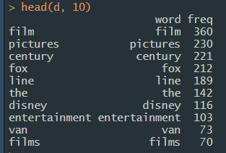
Text Mining
Production companies more consistent over time
Most frequent production companies in data set

Slide 18
Conclusions
Areas that could provide entertain value:
Top directors, writers, and production companies can more accurately predict the success of a movie in terms of IMDb scores (e.g., correlates to gross revenue)
Profitability of specific categories:
Comedy movies had the best return on investment (e.g., budget versus gross revenue)
Models that could predict future success:
Clustering more clearly identified successful movie attributes
k-NN classification model was more successful as supervised learning to train for better predictions

Slide 19
Questions?

Slide 20
Sample Top Performers (short list)
Top Writers
Top Production Co.
Top Directors
Top Stars
Back to slide 5

Slide 21
Data Dictionary
Term | Description
budget | the budget of a movie. some movies don't have this, so it appears as 0
company | the production company
country | country of origin
director | the director
genre | main genre of the movie
gross | total revenue of the movie
gross overseas | revenue of the movie overseas
gross us | revenue of the movie in the us
more success overseas | higher revenue overseas than in the us
movie title | name of the movie
rating | rating of the movie (R, PG, etc.)
released | release date (MM-DD-YYYY)
runtime | duration of the movie
score | IMDb user rating
star | main actor/actress
votes | number of user votes
writer | writer of the movie
year | year of release

Slide 22
Problem
Cinema is increasingly competing with streaming services for entertainment.
Drivers:
Theatrical experience
Tickets cost
Movie availability
Return on Investment
Business question:
How can Cinema increase the entertainment value of its movies?
Notes:
Business Question: How can the box office compete or co-exist with streaming services?
Some ways to address this would be to identify the strengths and weaknesses or historical movie data to identify opportunities to maintain high entertainment value (e.g., produce more good movies worthy of a theatrical experience).

Slide 23

Data
Movies data set
Records data/tabular format (.csv file)
18 attributes, 6800+ observations
Numeric (budget, gross revenue, runtime)
Nominal (genre, rating, score, success overseas, country of origin)
Text (movie titles, stars, directors, writers, studio)
Limitations: most current data is from 2016, overseas gross revenue unavailable for all movie titles

Slide 24

Data Preprocessing
Data merge
Feature selection
All, excluding dimensional reduction attributes
Dimensional reduction
Success overseas, gross overseas
Normalization
Discretize data categories
Restructuring data types (e.g., dates)
Data sub setting
Training data and testing data (70%, 30% initially)

Slide 25
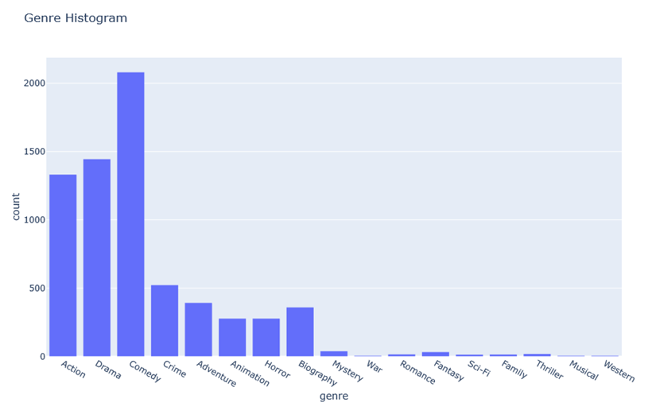
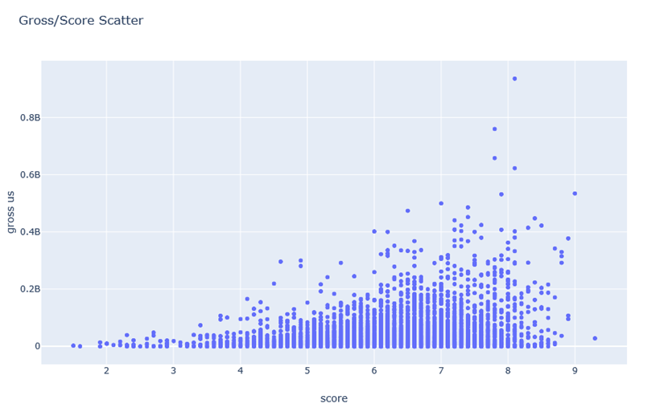
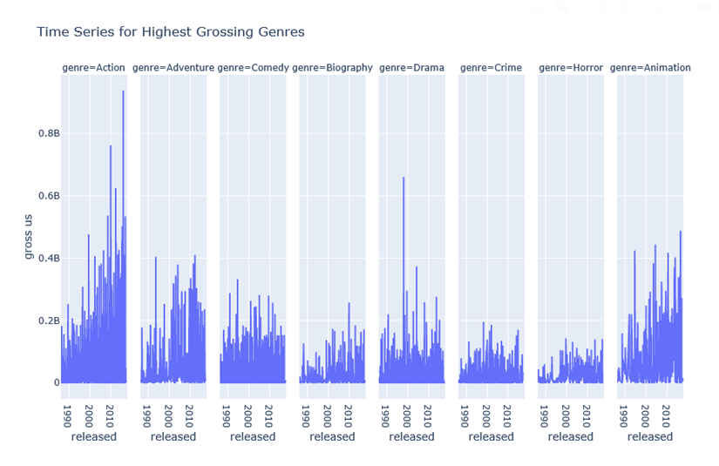
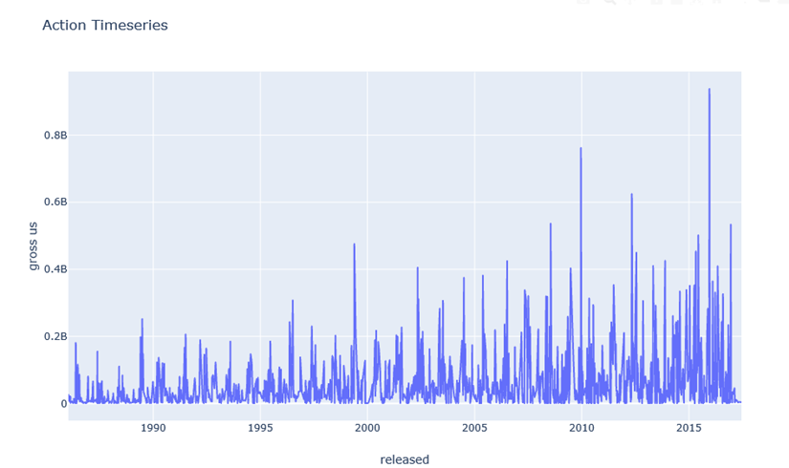
Exploratory Data Analysis

Slide 26
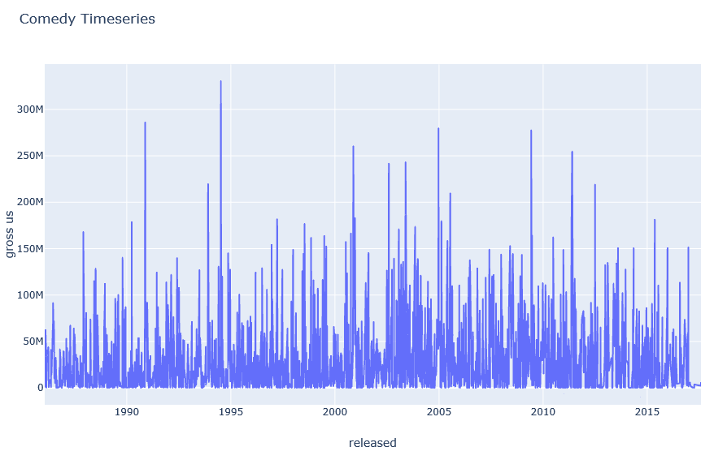
Exploratory Data Analysis

Slide 27
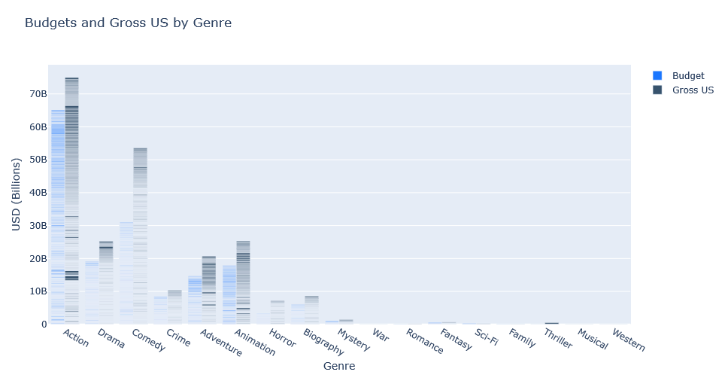
Exploratory Data Analysis

